Slide 1
The SPI Interface

Slide 2
Background
Is a serial bus standard as much as the I2C
Established by Motorola
Used for communication with slow peripheral devices
Many EEPROMS, ADC, sensors communicate with the controller through this standard

Slide 3
Characteristics
Full Duplex Communication unlike I2C and hence faster
Master or Slave Operation
Only one master in general
No slave addresses unlike I2C
Hence having multiple slaves can be a hardware effort while multiple masters is not recommended

Slide 4
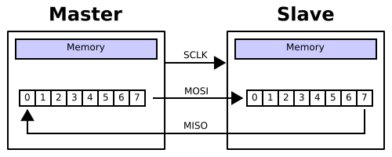
General Idea
Imagine data being circulated through 2 shift registers with every clock pulse between master and slave.
Master to Slave via the MOSI line and Slave to Master via the MISO line
It is up to the master and slave devices to know whether a received byte is meaningful or not. So a device must discard the received byte in a "transmit only" frame or generate a dummy byte for a "receive only" frame.

Slide 5

Signals
The SPI bus specifies four logic signals.
SCLK /SCK— Serial Clock (output from master)
MOSI/SIMO — Master Output, Slave Input (output from master)
MISO/SOMI — Master Input, Slave Output (output from slave)
SS — Slave Select (active low; output from master)

Slide 6
Master Side
Master pulls the SS line low, indicating start of communication
Next the master writes the data to SPI data register (SPDR)
This triggers the clock and the data is shifted into the shift register on the slave through the MOSI line
After shifting a byte the clock is stopped and SPI end of transmission flag (SPIF) is set.
If SPIE is enabled this can enable the interrupt
The master then shifts the next byte into SPDR or pulls the SS line high indicating end of transmission

Slide 7
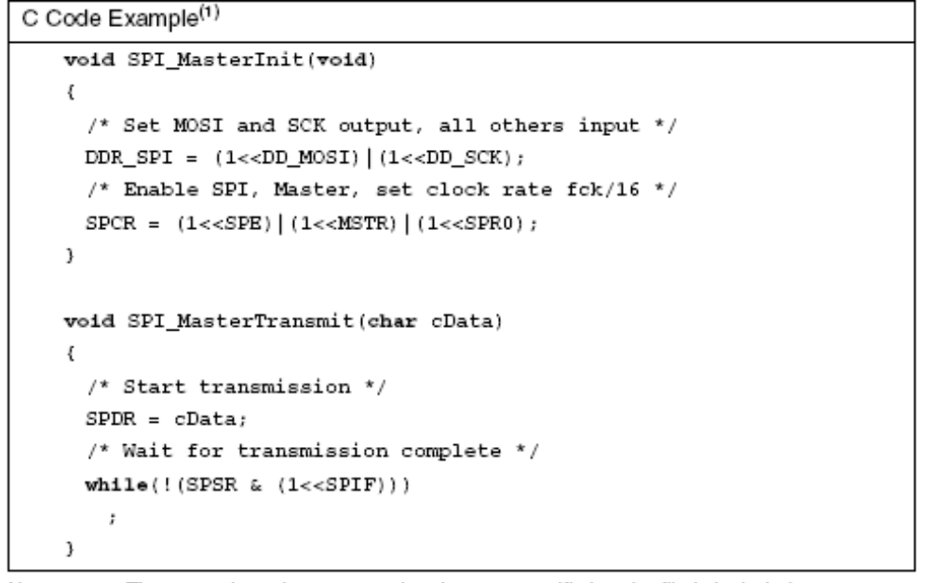
Master Side

Slide 8
Slave Side
If the Slave is a device other than ATMega8 then one needs to look into its datasheet
If it is a ATMega8
  As long as the SS line is high it has no effect
  If the SS line is low the data is shifted into the shift register with every clock
  When the clock is stopped the controller can either read this data or place a new data into the SPDR or both
  The new data gets shifted out with the next clock

Slide 9
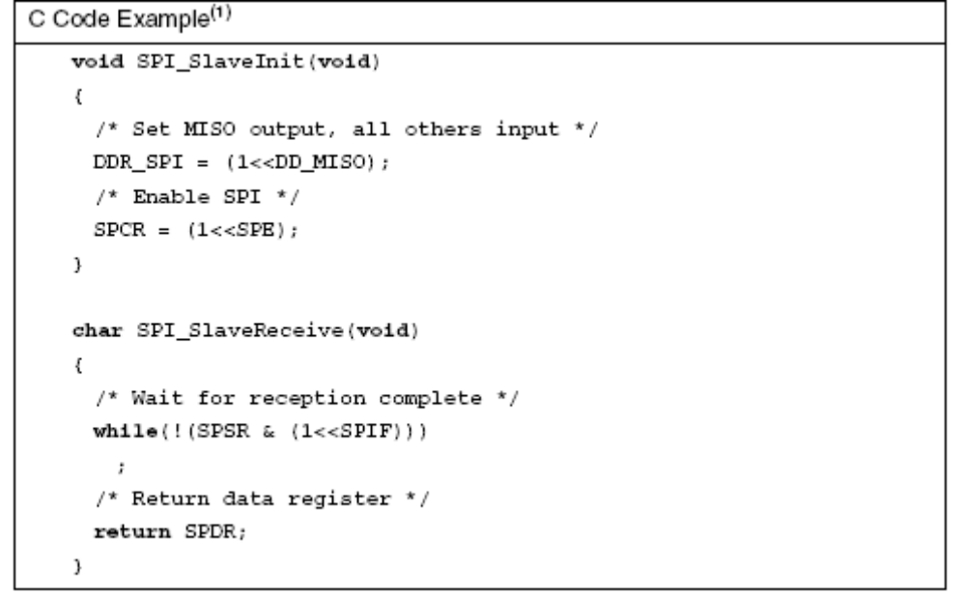
Slave Side

Slide 10
Asking Slave Device to Transmit
Depends on the Slave Device
One possible way is
  The Slave looks for a particular bit in the word being circulated
  Based on the setting of the bit it understands if it needs to parallel load a new value such as ADC value or GPS value
  The master stops the clock
  Slave loads the required value
  The master starts the clock and the data being circulated into the shift register of master is the data required by it.

Slide 11
Lack of Standardization
Different word sizes
Different symbols followed
Slave select active high than active low
MSB shifted out first or LSB
No hand shaking protocol between Master and Slave

